Slide 1
Echo of climate change
— Solve it now or lie flat?
Ruixuan Huang
PB20111686

Slide 2
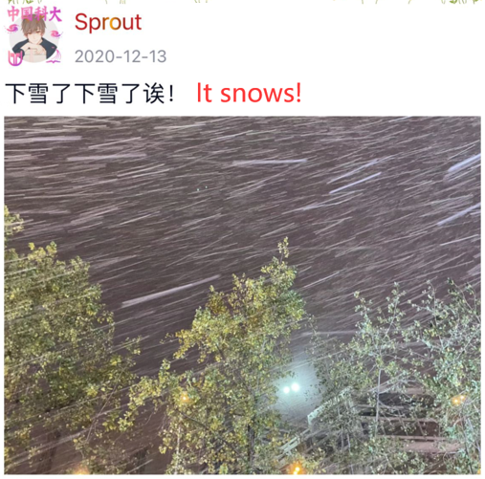
Just one year before……
Pay attention to the post time.
Notes:
It's a nice day today, isn't it? You can see cloudless sky, warm sun and chirping birds. But the worry is that it is late December - generally speaking, Anhui will be very cold at this time. When I opened wechat moments of last year, I was surprised to find that it had snowed heavily in Hefei in early December last year, and the snow and ice weather continued until February this year.

Slide 3
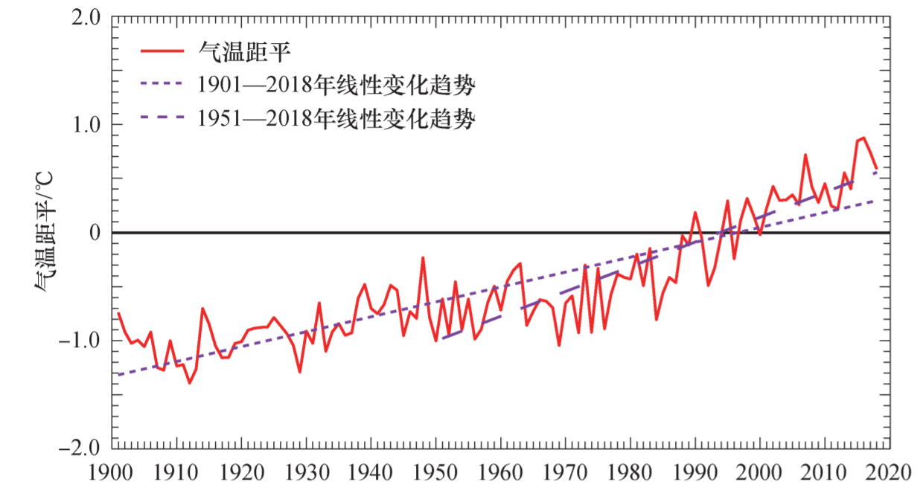
Viewing statistics……
Referrence : China's blue book on climate change
Notes:
Although last year and this year, this is only an example. However, when I saw the statistics, I found that the trend of climate change was clearly visible. It's hard to imagine that in Anhui, far north of my home, winter will be as warm as this year.

Slide 4
The impact
Notes:
Now we are going to talk about the impact.

Slide 5

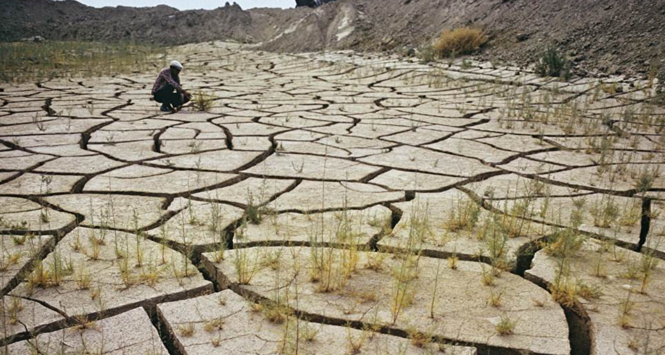
Non-ignored Reality
Rise of sea level
Spread of dormant bacteria
Increase the risk of injury
Food and water shortages
Mankind displacement
Notes:
At present, we are in the initial stage of climate warming. It has been observed that sea level rise has caused irreparable losses to many coastal countries. At the same time, it is also recognized that climate warming will lead to the spread of dormant bacteria in the ice. However, scientists believe that climate change will not only lead to the spread of infectious diseases such as respiratory diseases, but also increase the risk of injury, and the number of deaths is also increasing every year. Climate change worsens chronic(慢性的) and infectious disease, causes more serious food and water shortages and increases mass displacement(人口流离失所).

Slide 6
The dispute
Notes:
Climate change is a common challenge faced by all countries. Countries all over the world need to work together to take effective measures to protect our earth home. However, at present, the climate change problem discussed by countries is not just a simple scientific problem. It is a topic mixed with national interests and political factors.

Slide 7
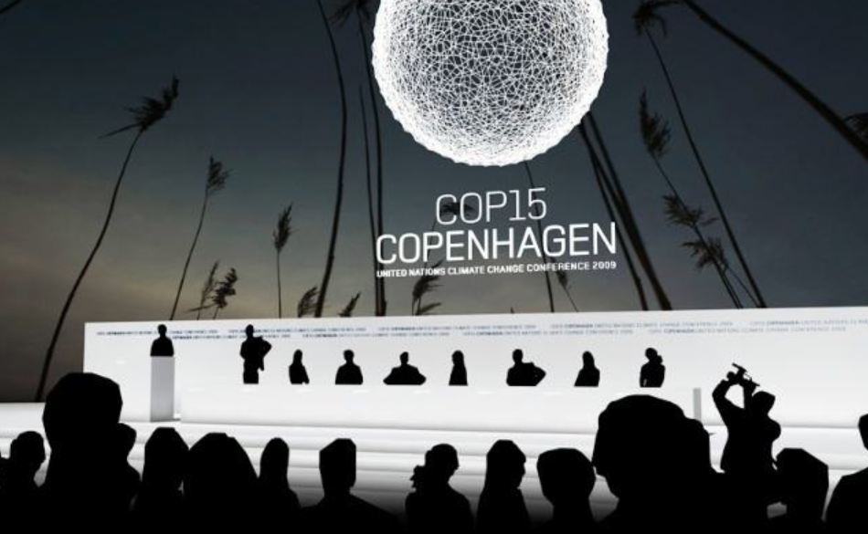
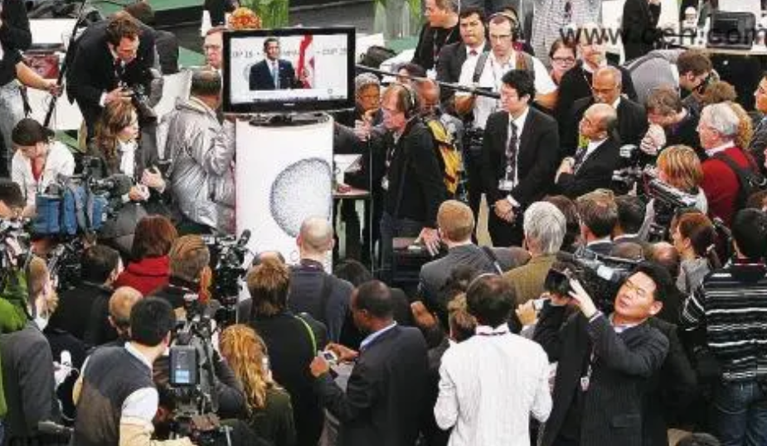
Endless dispute in negotiation……
Notes:
Any country needs to consume a lot of energy in the primary industrial stage, and Western countries have long completed the primary industrial process. Coal is a cheap and stable energy, but carbon emissions discredit fossil energy and force developing countries to eliminate coal prematurely, so it is difficult for developing countries to successfully complete industrialization.

Slide 8
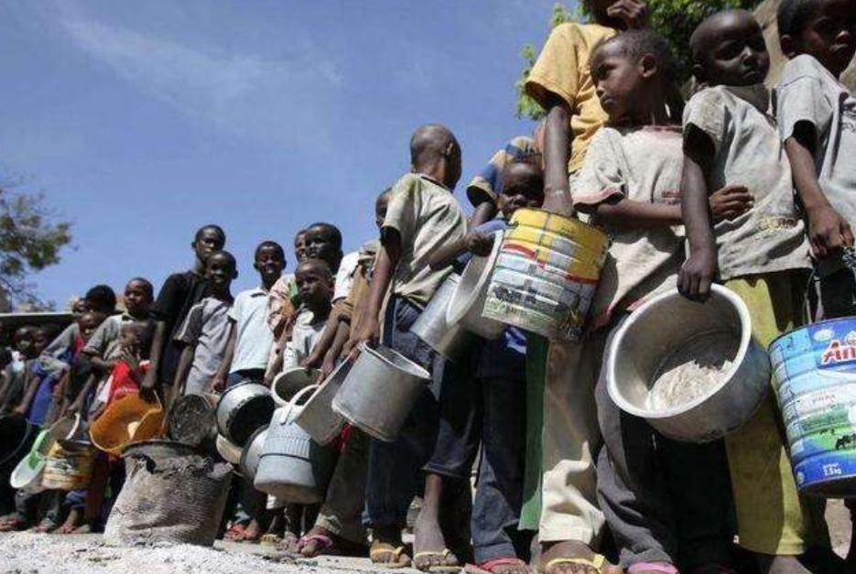
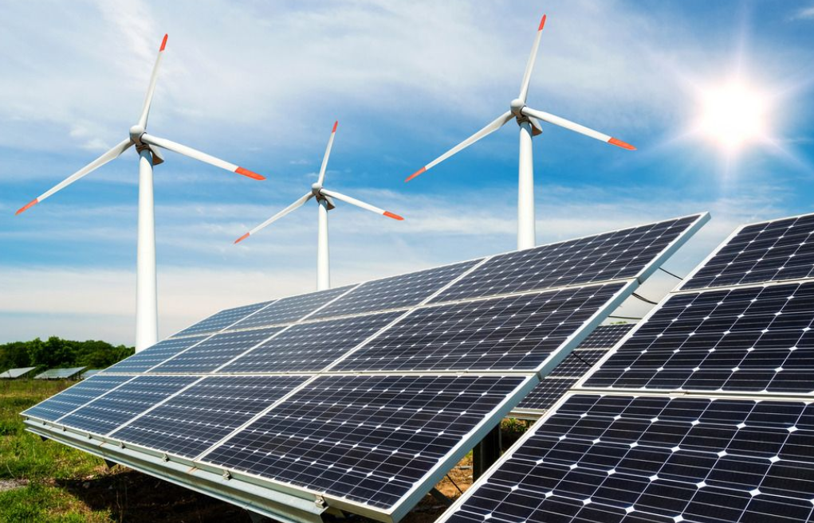
Who will speak for the poor countries?
Why should developing countries sacrifice their development prospects for climate change?
Notes:
Developing countries without industry cannot compete with western countries. They can only continue to play the role of providing primary resources, cheap labor and dumping market of industrial products in the global division of labor formulated by western countries, and are at the lowest end of the value chain.

Slide 9
The “solution”
Notes:
Obviously, we can't disseminate any action guidelines on climate change through a single presentation. So now I want to talk about how to deal with climate change from my cognition.

Slide 10










Recognizing the Complexity
Climate change
true scene
politics and interests
humankind development
Notes:
In essence, global warming is caused by excessive carbon emissions. Limiting carbon dioxide emissions can alleviate the greenhouse effect to a certain extent. At present, the main means to alleviate global warming is to "reduce fossil energy and turn to renewable energy". Solar energy, wind energy and hydropower essentially use the energy from the sun and will not burn to produce carbon dioxide. These technologies are relatively mature, but their economic benefits greatly limit their wide use. At the current technical level, it is not possible to meet all energy needs, which are provided by renewable energy.

Slide 11
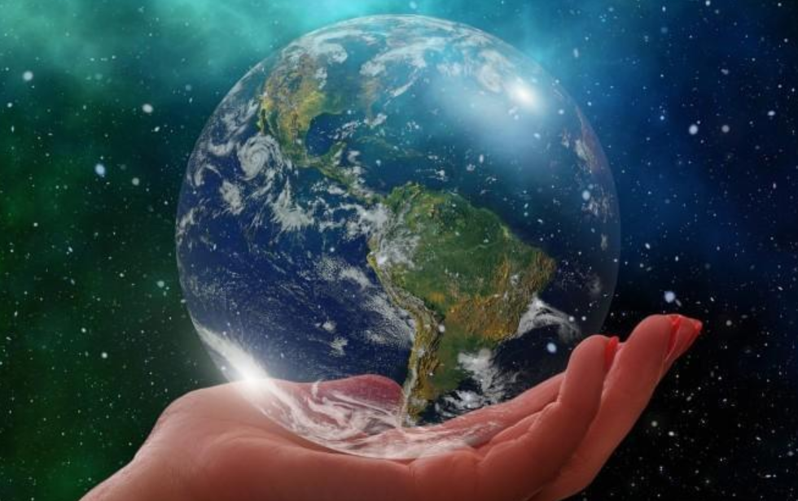
Conclude
Let time to give the answer……
Notes:
"Even the increment of renewable energy cannot meet the existing increment of total energy demand." We still have a long way to go to reduce the use of fossil energy. From today's perspective, the hope of solving the problem of global warming is still slim. On our way forward, we still need to cross three mountains: the imperfection of prediction theory, the economy of renewable energy technology and the distribution of carbon emission rights among countries. "There is a long way to go. Whether we are completely swallowed up by the darkness or torn by the light needs time to answer.

Slide 12
Thanks for listening!
Ruixuan Huang
PB20111686

